Slide 1
Confusing Trees
—by Qi Qu

Slide 2
A List of Trees
Binary tree
Binary search tree (BST)
Balanced tree
Self-balancing binary search tree
B tree
B+ tree
Trie tree

Slide 3
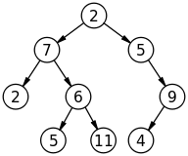
Binary Tree
Each node has at most 2 children

Slide 4
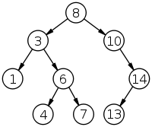
Binary Search Tree (BST)
A binary tree
Keeps nodes in order

Slide 5
Balanced Tree
each sub-tree is balanced
the height of the two sub-trees differ by at most one

Slide 6
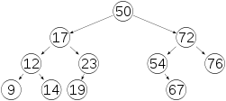
Self-balancing binary search tree
binary search tree
automatically keeps its height small

Slide 7
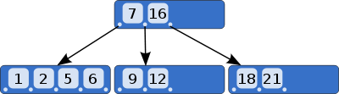
B tree
self-balancing
keeps data sorted
can have a variable number of child nodes

Slide 8
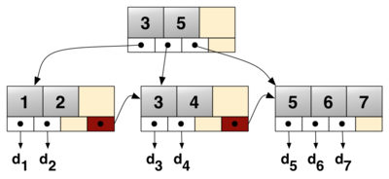
B+ tree
B tree
Leaves are linked at the bottom

Slide 9
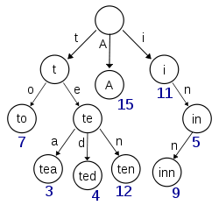
Trie Tree
Ordered
The position of the node in the tree defines the key with which it is associated

Slide 10
All Trees
Trees
Binary tree
Binary search tree (BST)
Balanced tree
Self-balancing binary search tree
B tree & B+ Tree
Trie tree
…

Slide 11
Thank you!

